Slide 1
Twitter Sentiment Analysis

Slide 2
Group Names:
Somia Ahmed Mohamed Abdelazim
Sahar Maher Abdelmoniem
Zad Walid Medhat
Sherine Tarek Berges

Slide 3
Data collection & Data Preprocessing

Slide 4
AGENDA
Dataset Collection
Data cleaning
Data Exploring using EDA
Data Preprocessing

Slide 5
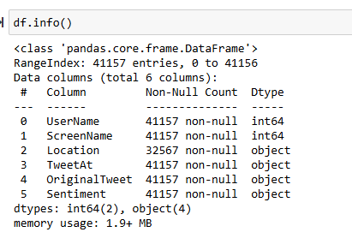
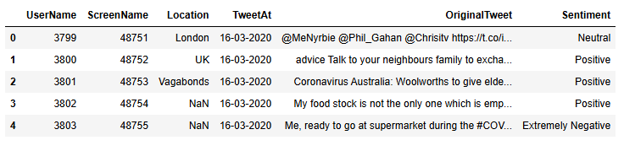
About Dataset

Slide 6
Data Exploring by using EDA:

Slide 7
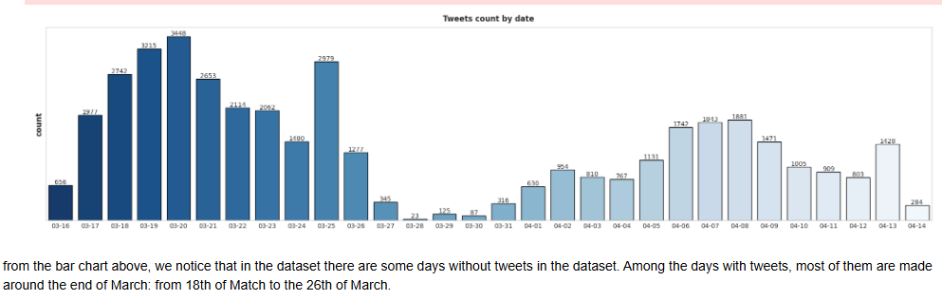
Number of tweets per day :

Slide 8
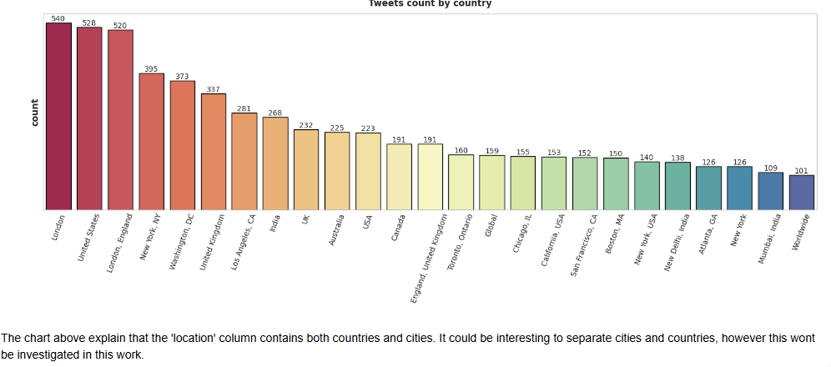
Number of tweets per Country & City

Slide 9
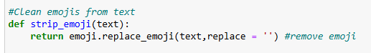
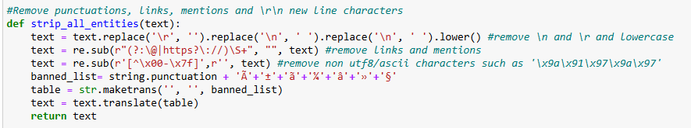
Data Preprocessing

Slide 10
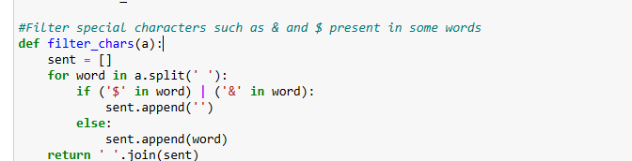
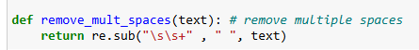

Slide 11
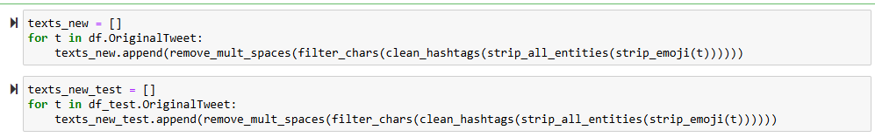
Applying the functions on Training & testing Data

Slide 12
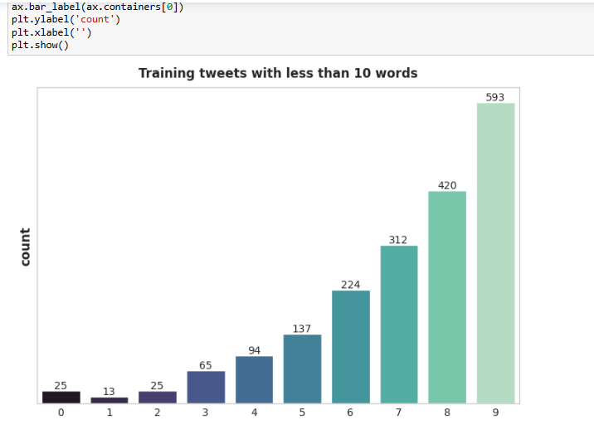
Let’s get the tweets with words less than 10

Slide 13
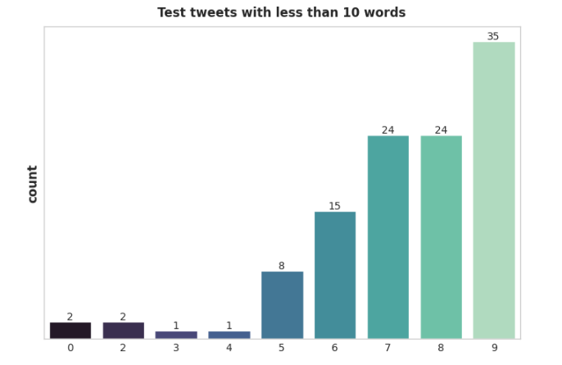
As we can see, there are lots of cleaned tweets with 0 words: this is due to the cleaning performed before. This means that some tweets contained only mentions, hashtags and links, which have been removed. We will drop these empty tweets and also those with less than 5 words.

Slide 14
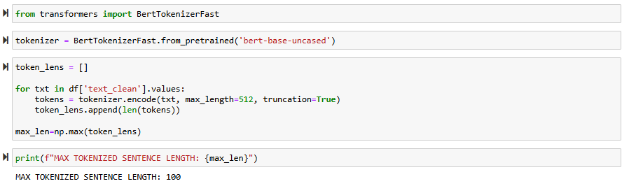
Performing Tokenization :

Slide 15
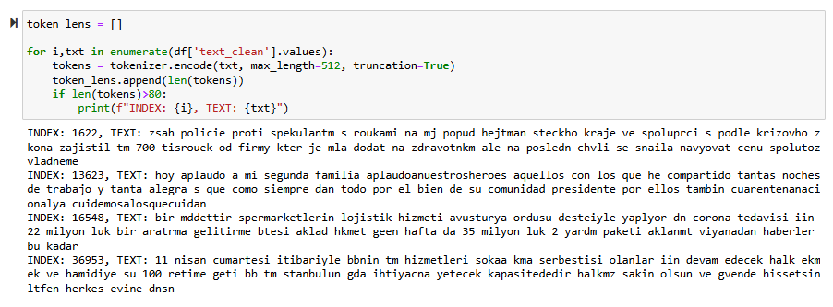
Let’s check the sentences with more than 100 words
These sentences are not in english. They should be dropped.

Slide 16
Let’s check the sentences with more than 100 words
These sentences are not in english. They should be dropped.

Slide 17
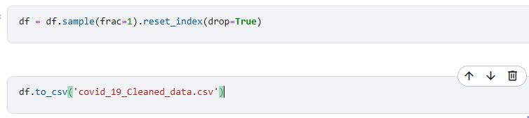
Data shuffling & reset the index
.

Slide 18
Eda & Machine learning By: Zad walid

Slide 19
Agenda
Eda & Formatting
Apply machine learning model
Make predictions

Slide 20
Eda & data formatting

Slide 21
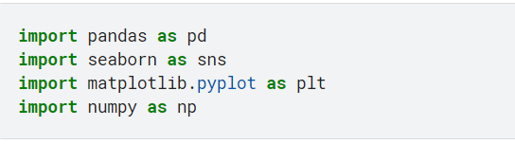
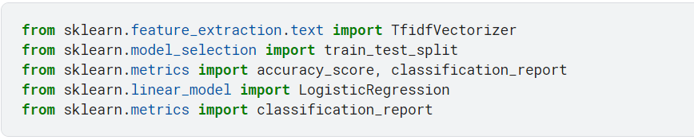
Import used libraries

Slide 22
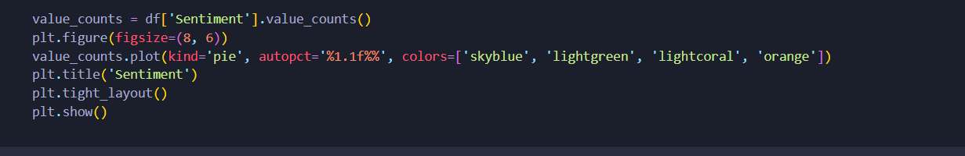
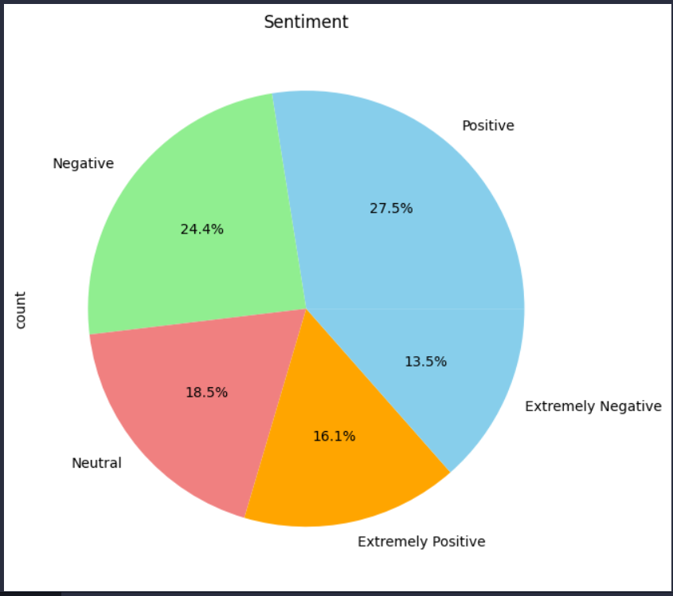
Exploratory data analysis
Seeing the distribution of data by exploring the Sentiment column which contains the type of tweets which vary between (positive, negative, neutral , extremely positive and extremely negative )

Slide 23
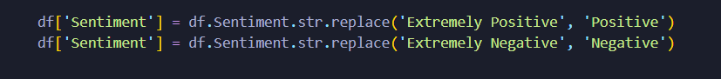
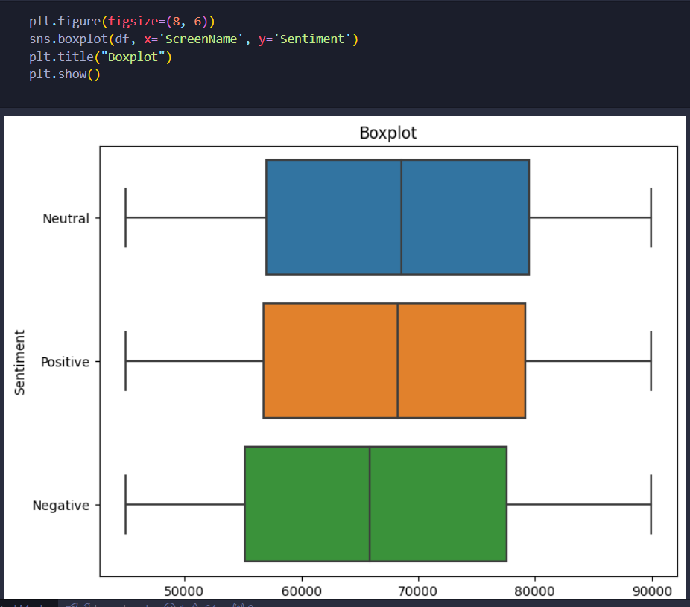
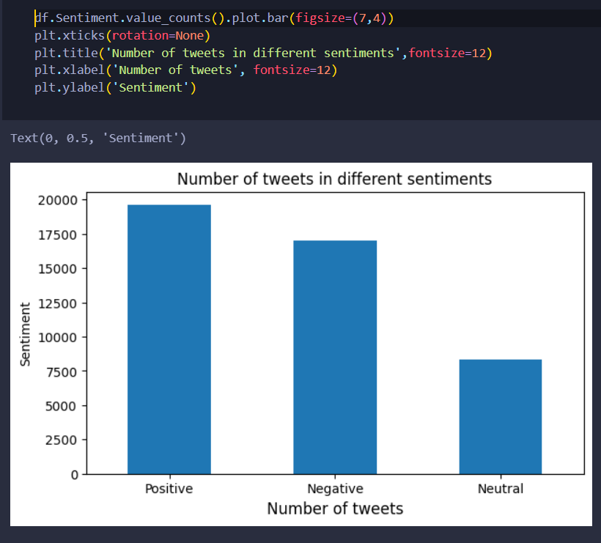
Box Plot
Bar Plot

Slide 24
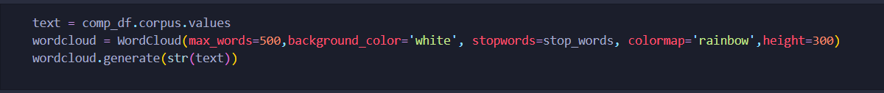
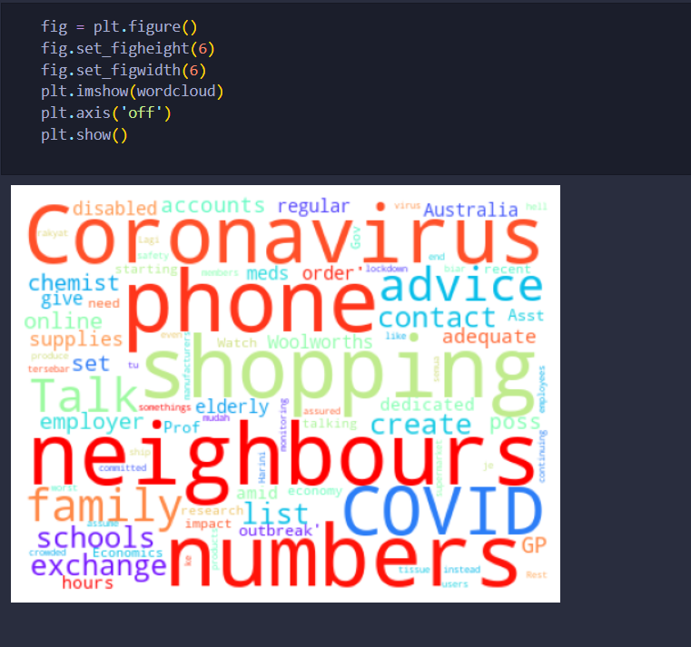
Word cloud visualization creating a word cloud from the tweets' text would help to identify which words are being most frequently used across the dataset or for specific sentiment categories, giving a quick insight into the content and themes of the tweets.

Slide 25
Machine learning models

Slide 26
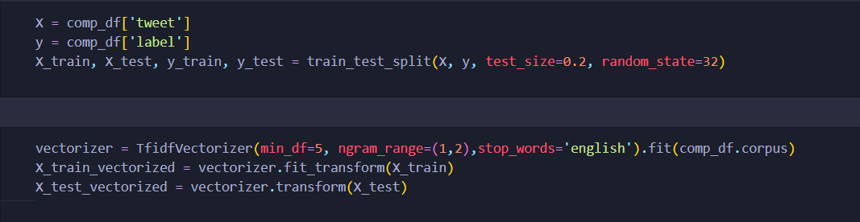
Preparing data
Steps:
Splitting the data
2. TfidfVectorizer(): Converts text data into numerical features using TF-IDF
3. Fits the vectorizer on the training data and transforms it into TF-IDF features.

Slide 27
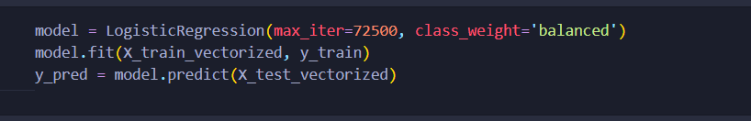
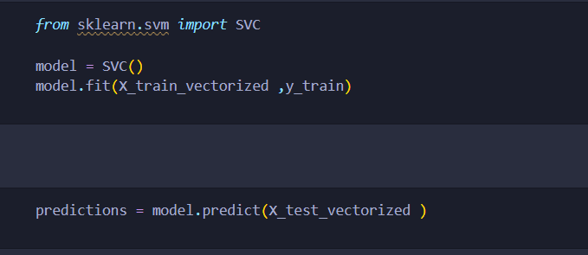
Apply Machine learning Models
Logistic Regression
SVM

Slide 28
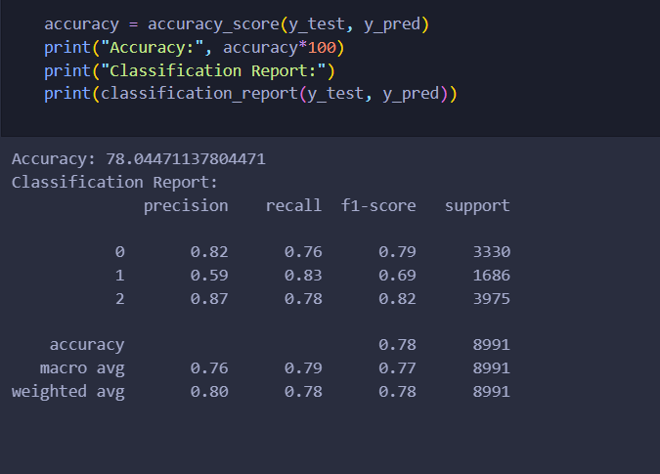
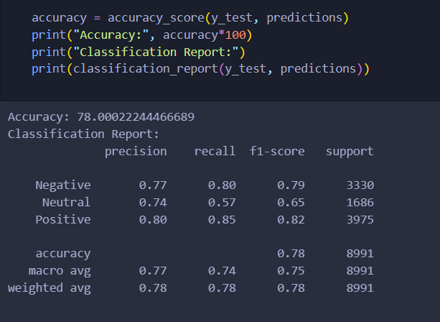
Classification reports
Logistic Regression
SVM

Slide 29
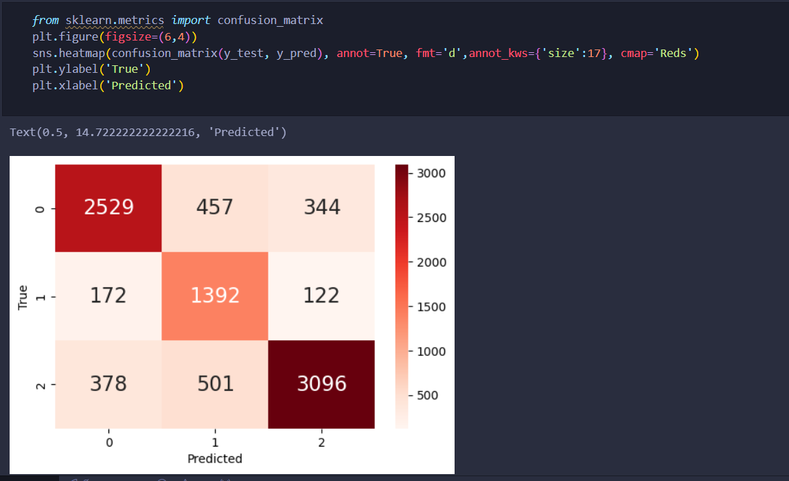
Confusion Matrix
Conclusion:
From the heatmap, it appears the model performs relatively well for class 2 (the last class), but there are some misclassifications between classes 0 and 1.

Slide 30
SAHAR MAHER

Slide 31
NLP with LTSM & RNN

Slide 32
AGENDA
Preparing Data
MODEL FUNCTION
RNN MODEL
LSTM MODEL

Slide 33
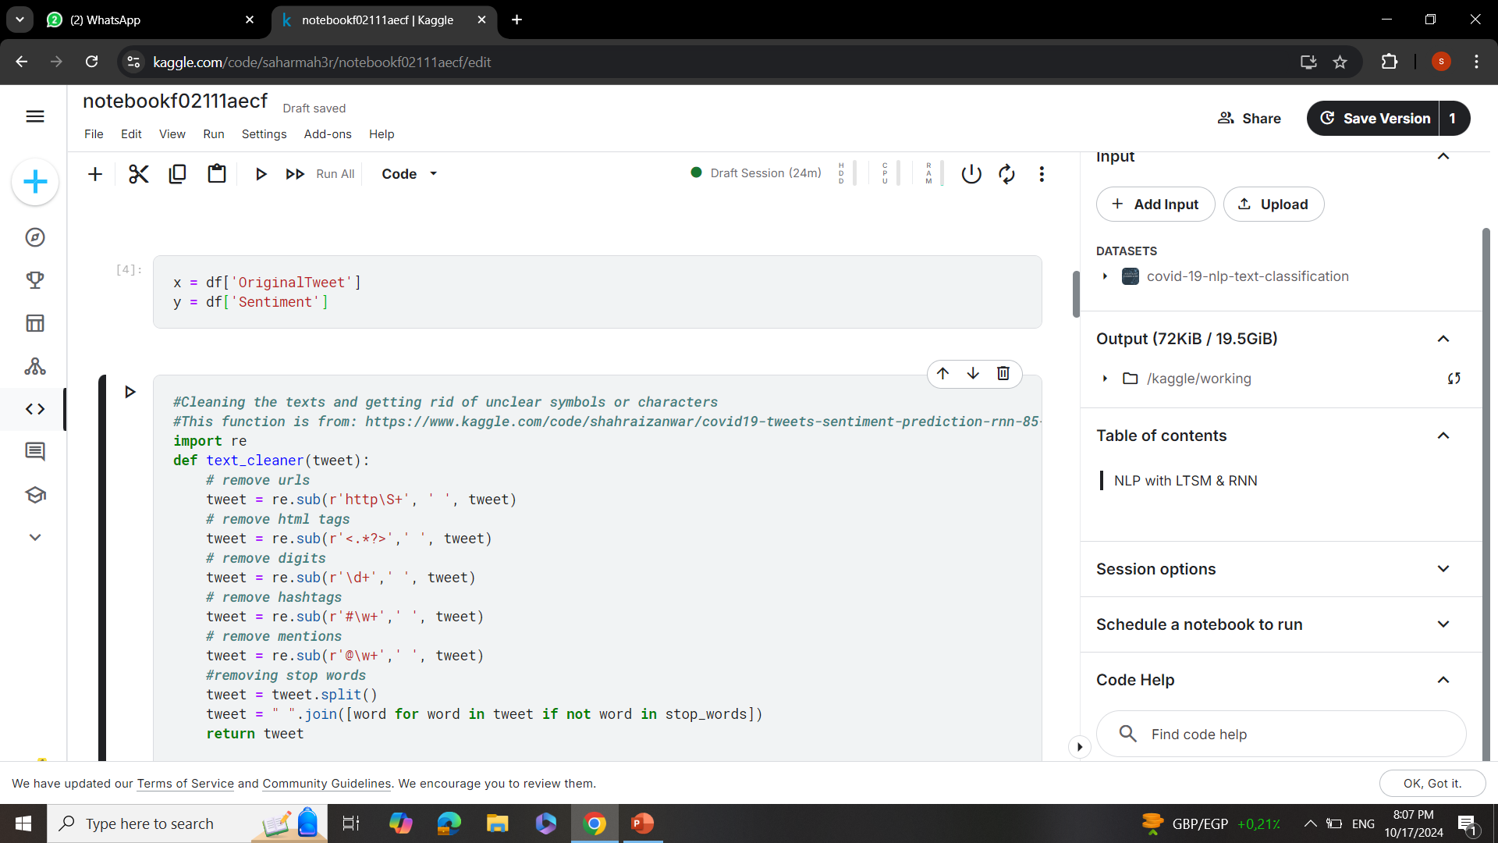
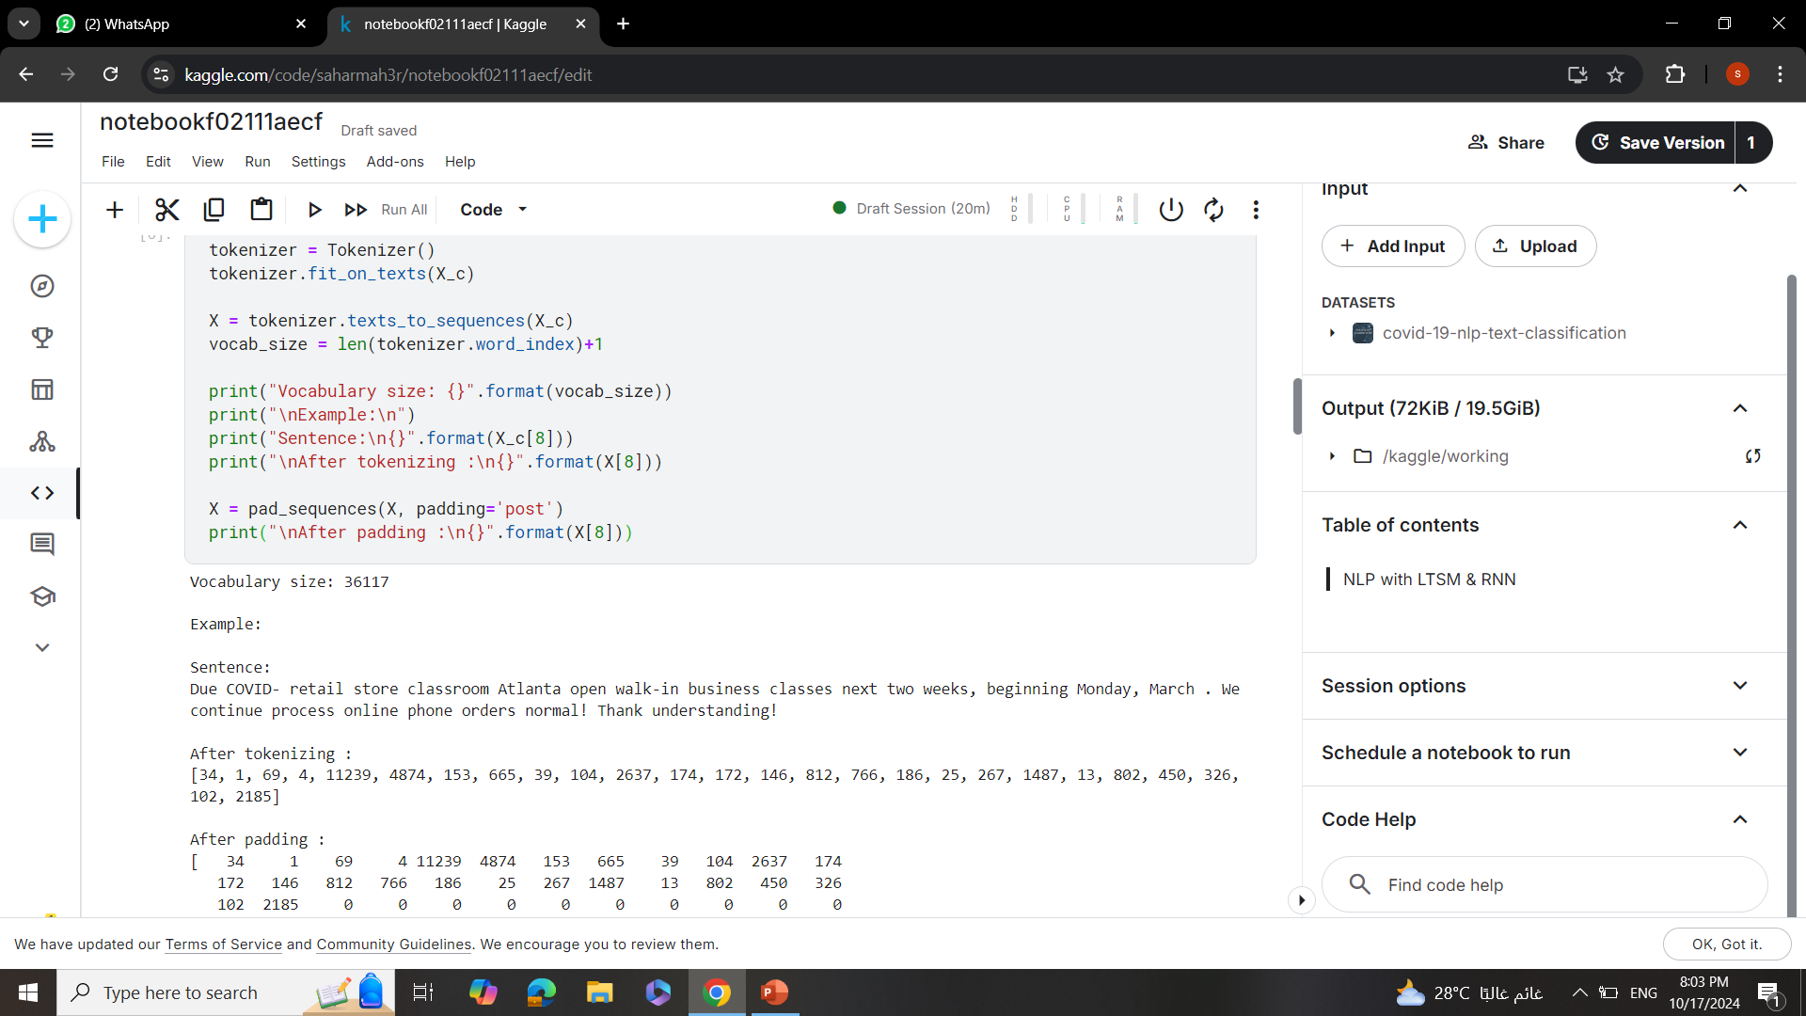
Preparing Data

Slide 34
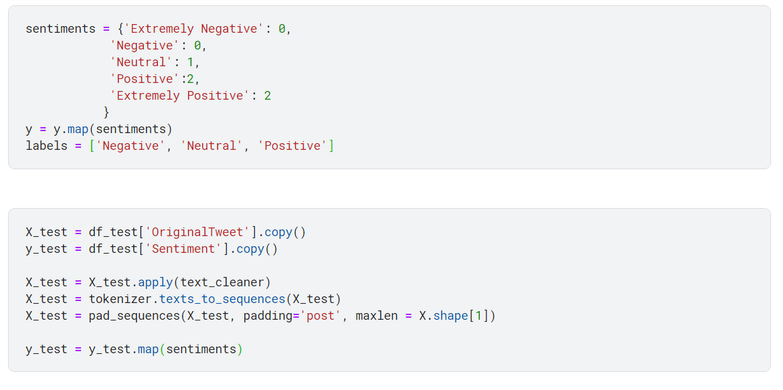
Preparing Data

Slide 35
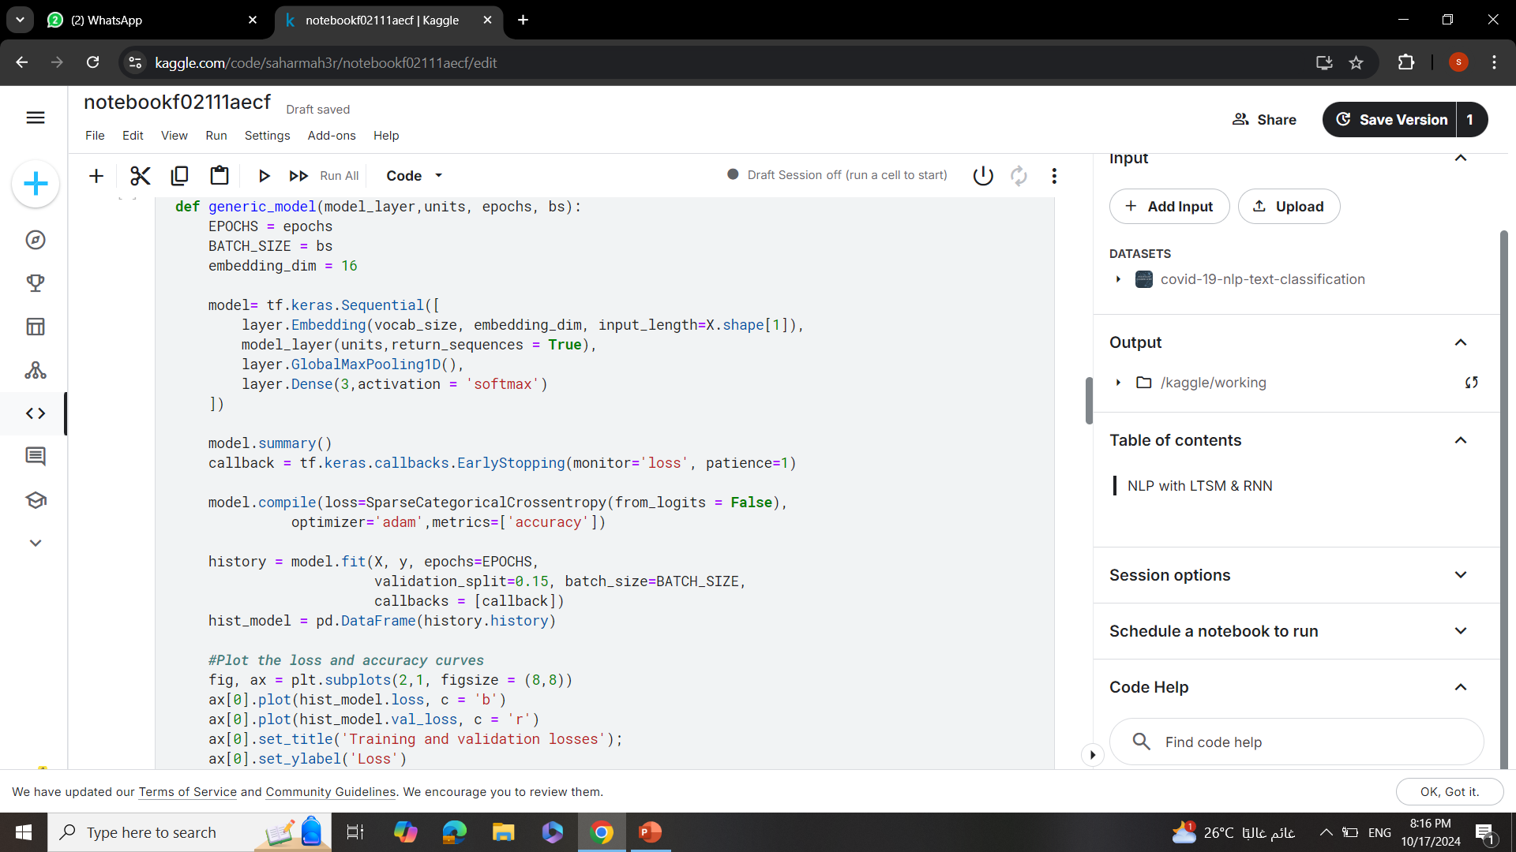
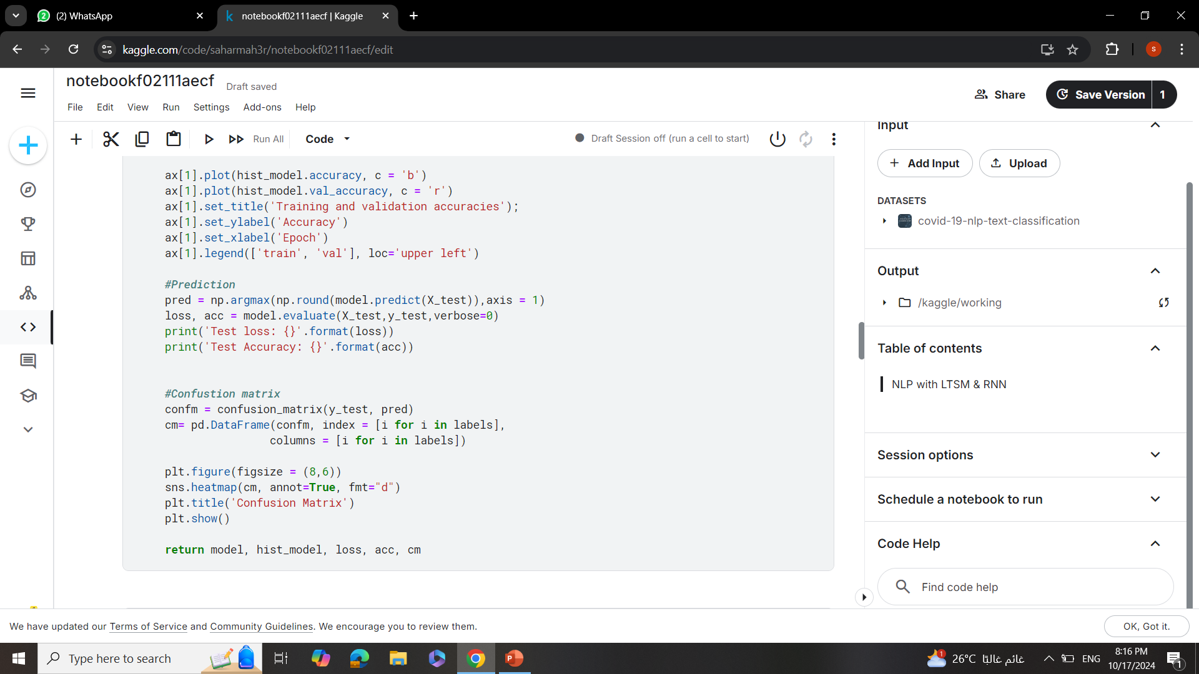
MODEL FUNCTION
.
.

Slide 36
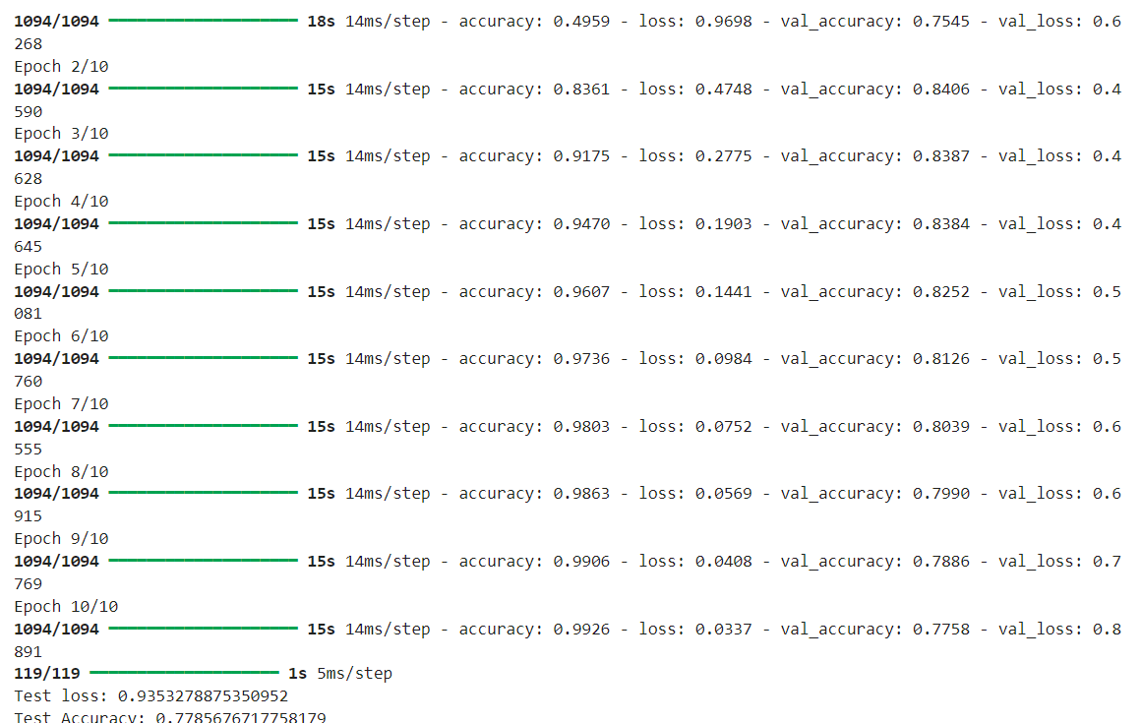
RNN MODEL
.
I used 10 epochs
And batch size = 32
With test loss of 0.9353
And test accuracy of
0.7785

Slide 37
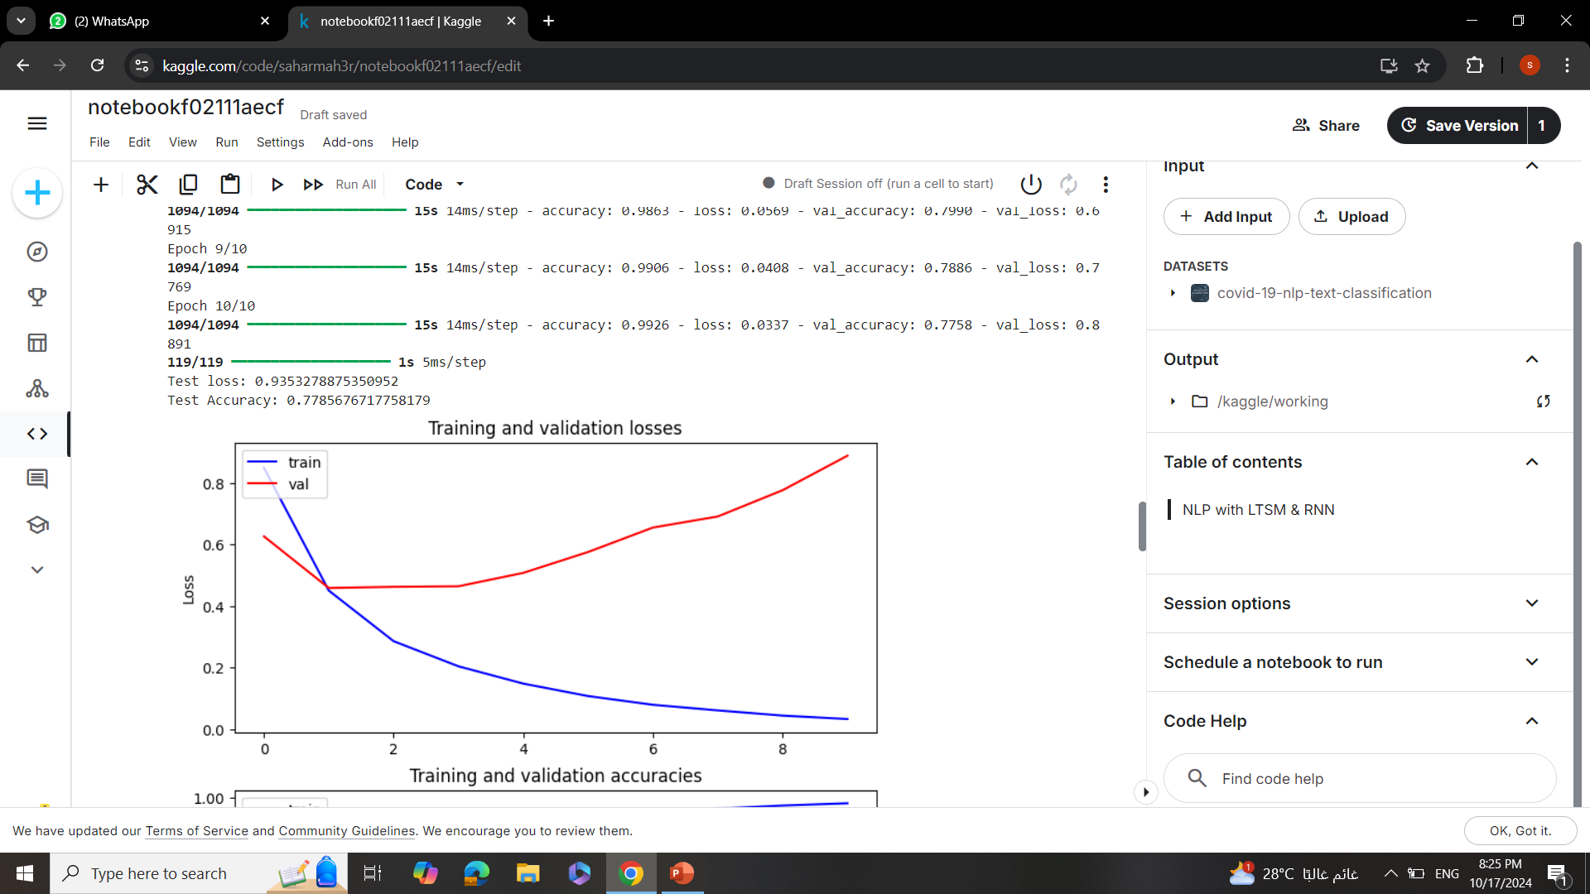
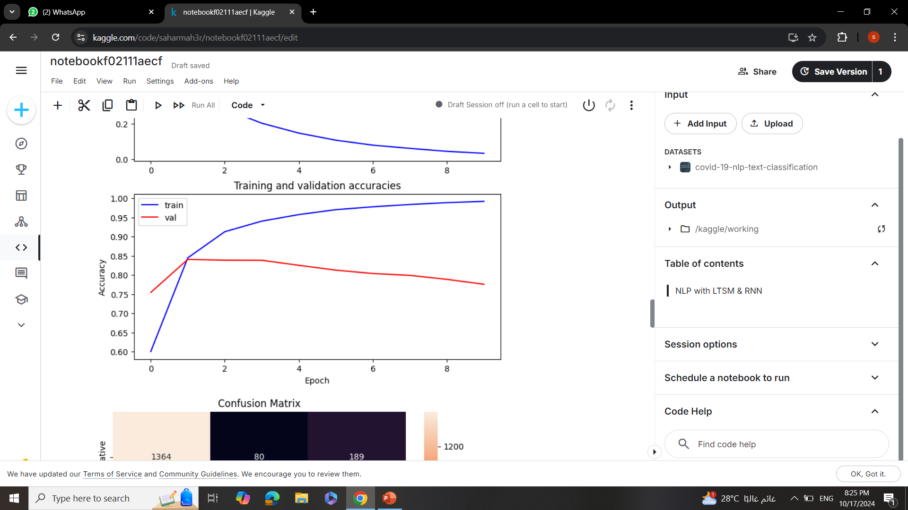
RNN
.
.

Slide 38
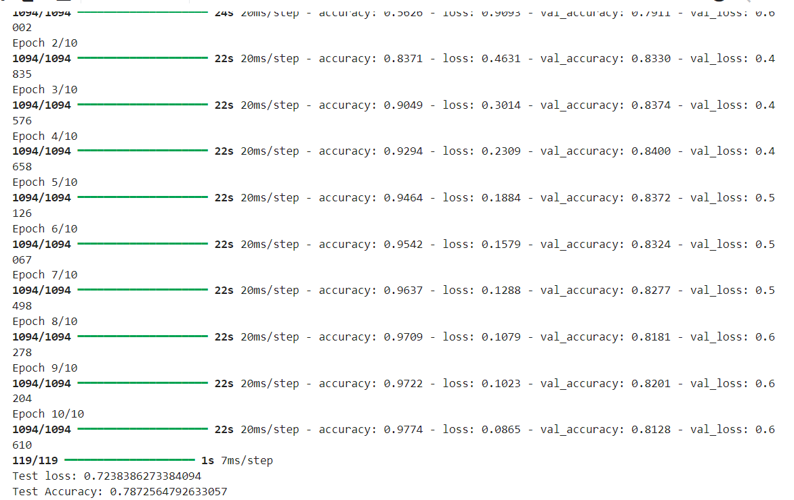
LSTM MODEL
.
I used 10 epochs
And batch size = 32
With test loss of 0.7238
And test accuracy of
0.7872

Slide 39
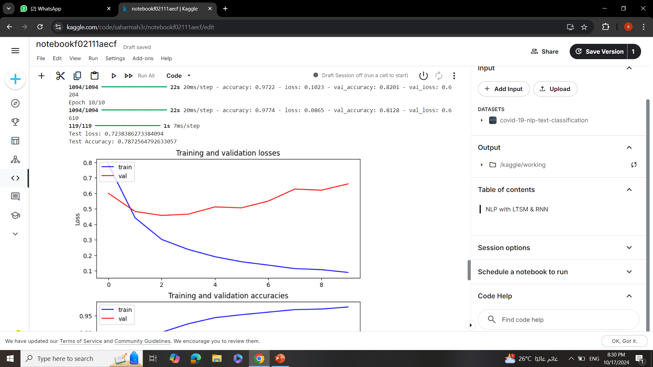
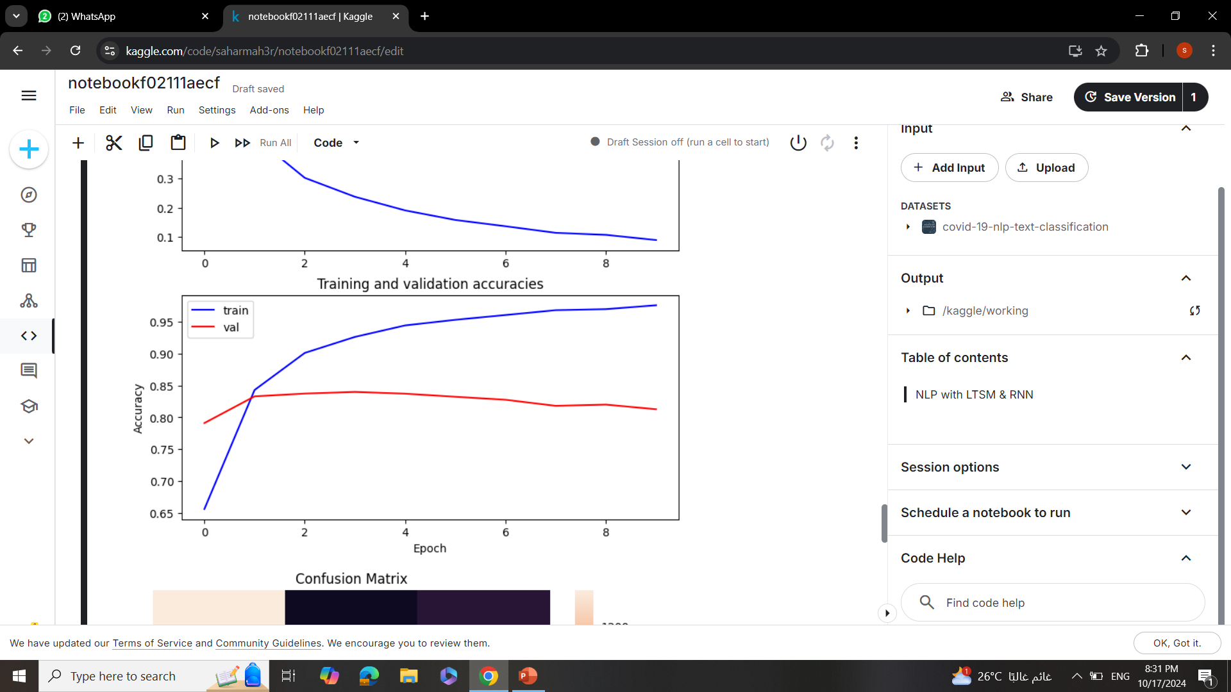
LSTM
.
.

Slide 40
Sherine TArek

Slide 41
NLP With Transformers [BERT]

Slide 42
Agenda
Prepare Data
Training
Prediction
Accuracy for every epoch
Confusion Matrix

Slide 43
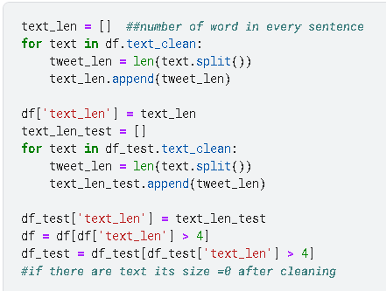
Prepare DATA

Slide 44
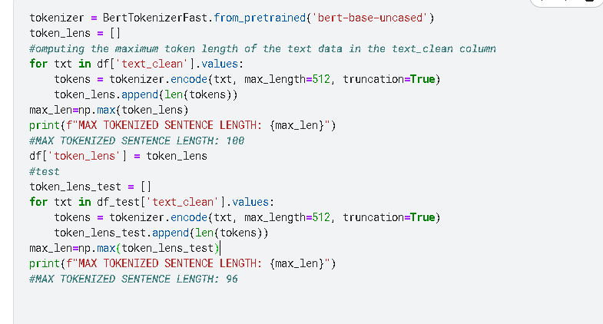
Prepare Data

Slide 45
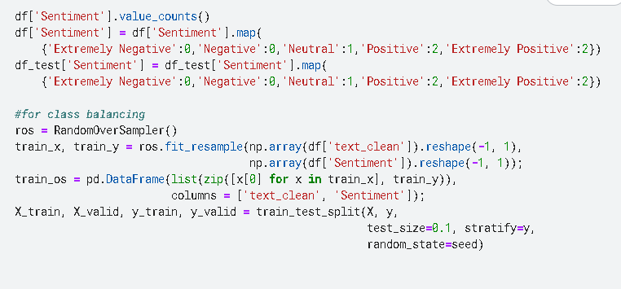
Splitting

Slide 46
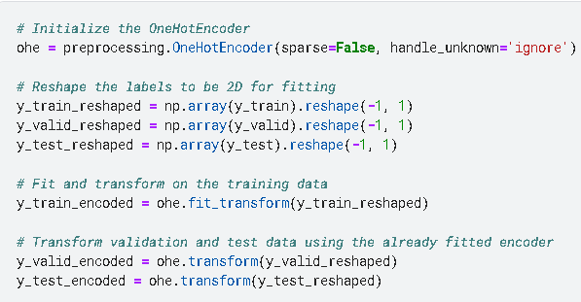
One Hot Encoding

Slide 47
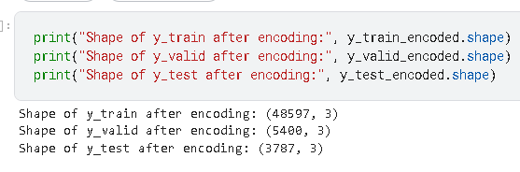
DAta after One Hot Encoding

Slide 48
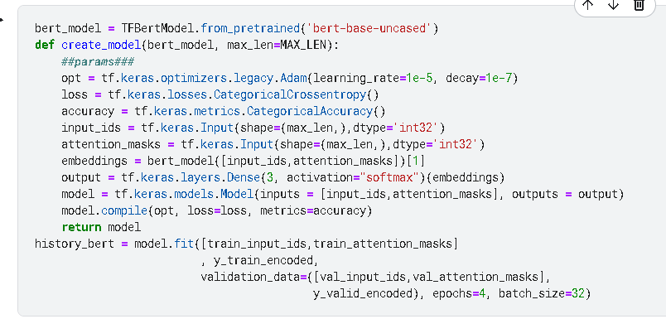
Model Functions

Slide 49
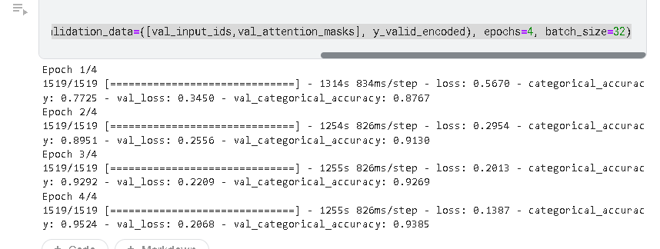
Accuracy for every epoch

Slide 50
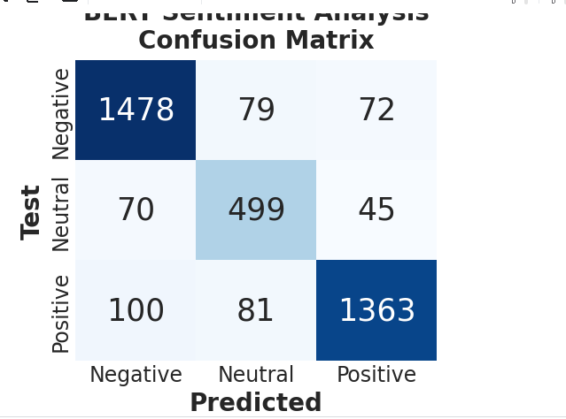
Confusion matrix

Slide 51
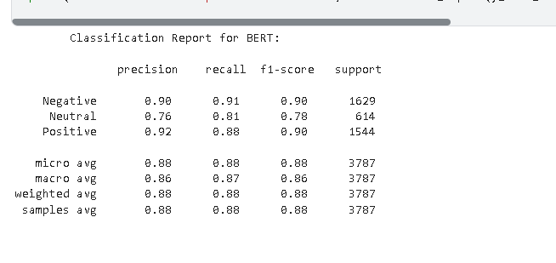
Model REport

